Slide 1
Timing
（时序）
Song Chen
October 15, 2015
http://staff.ustc.edu.cn/~songch/da-ug.htm

Slide 2
Outline
Sequencing
Sequencing Element Design
Max and Min-Delay
Clock Skew
Time Borrowing
Two-Phase Clocking
Timing Analysis

Slide 3
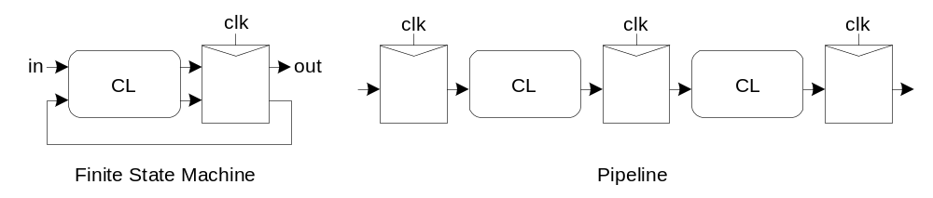
Sequencing
Combinational logic
  output depends on current inputs
Sequential logic
  output depends on current and previous inputs
  Requires separating previous, current, future
  Called state or tokens
  Ex: FSM, pipeline

Slide 4
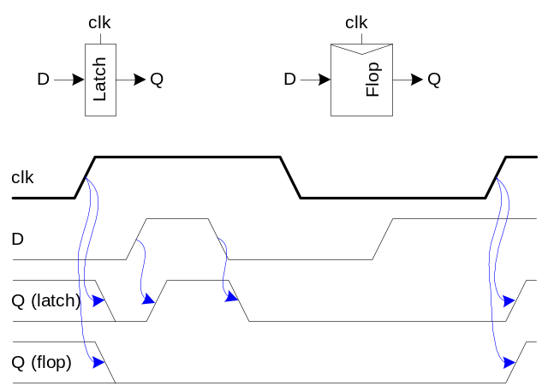
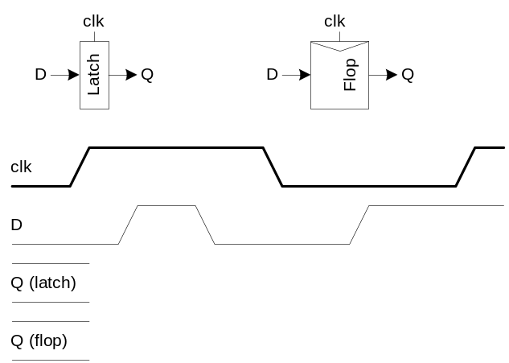
Sequencing Elements
Latch: Level sensitive
  a.k.a. transparent latch, D latch
Flip-flop: edge triggered
  A.k.a. master-slave flip-flop, D flip-flop, D register
Timing Diagrams
  Transparent
  Opaque
  Edge-trigger

Slide 5
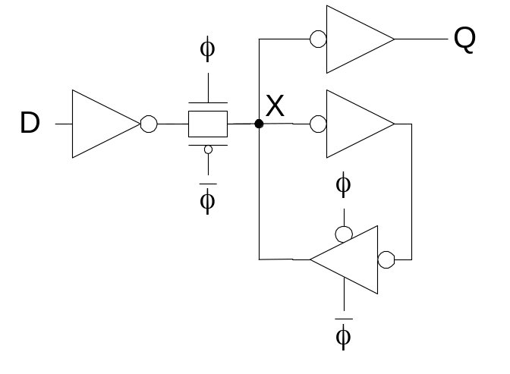
Latch Design
Widely used in standard cells
  + Very robust (most important)
  Rather large
  Rather slow (1.5 – 2 FO4 delays)
  High clock loading

Slide 6
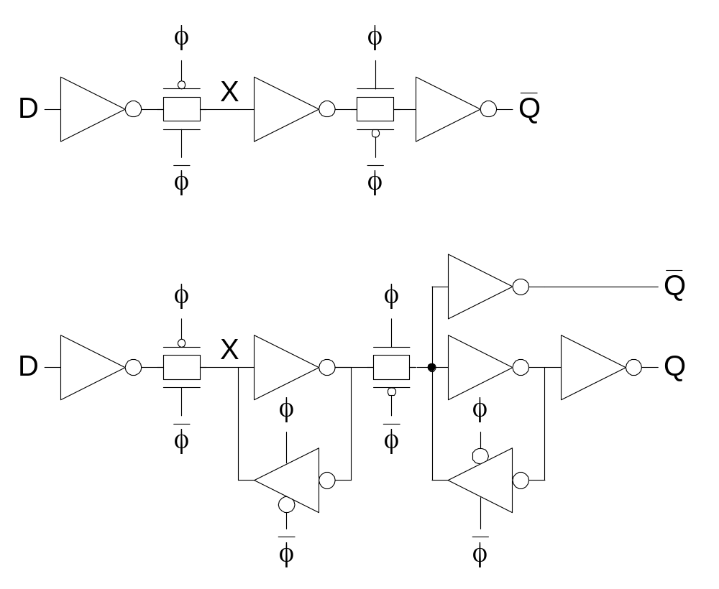
Flip-Flop Design
Flip-flop is built as pair of back-to-back latches

Slide 7
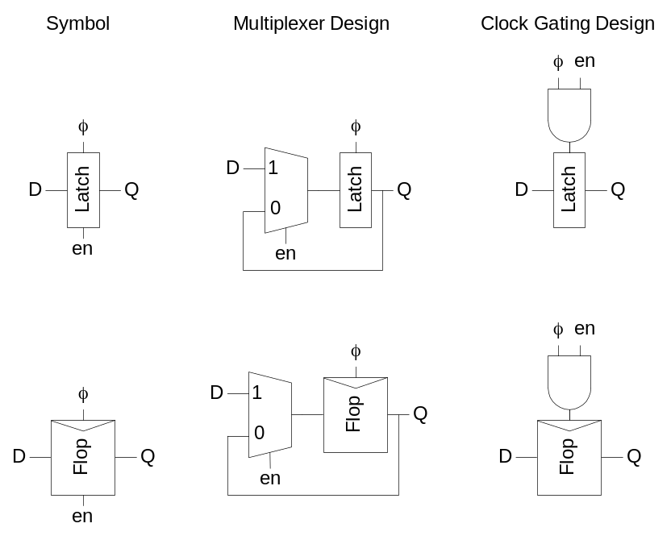
Enable
Enable: ignore clock when en = 0
  Mux: increase latch D-Q delay
  Clock Gating: increase en setup time, skew

Slide 8
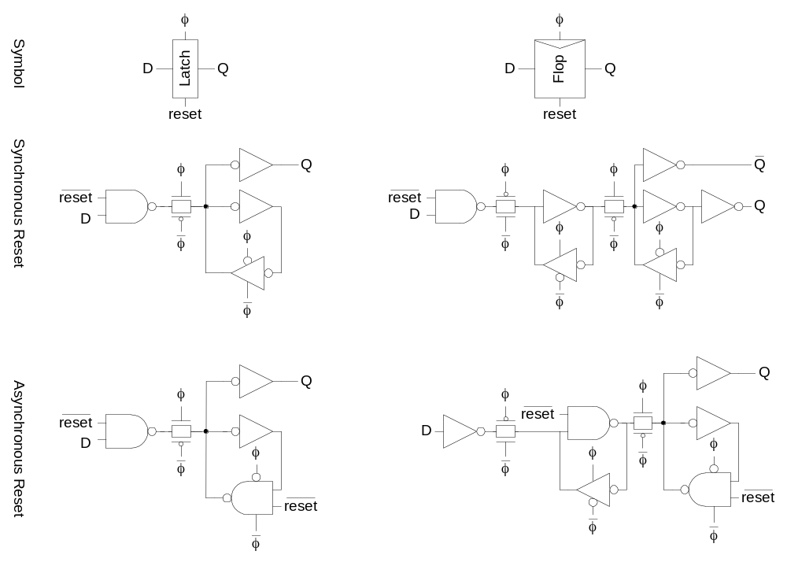
Reset
Force output low when reset asserted
Synchronous vs. asynchronous

Slide 9
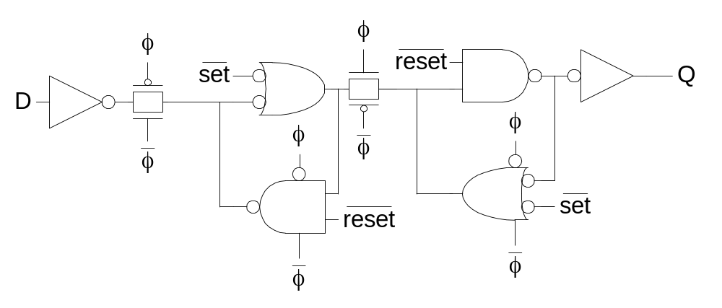
Set / Reset
Set forces output high when enabled
Flip-flop with asynchronous set and reset

Slide 10
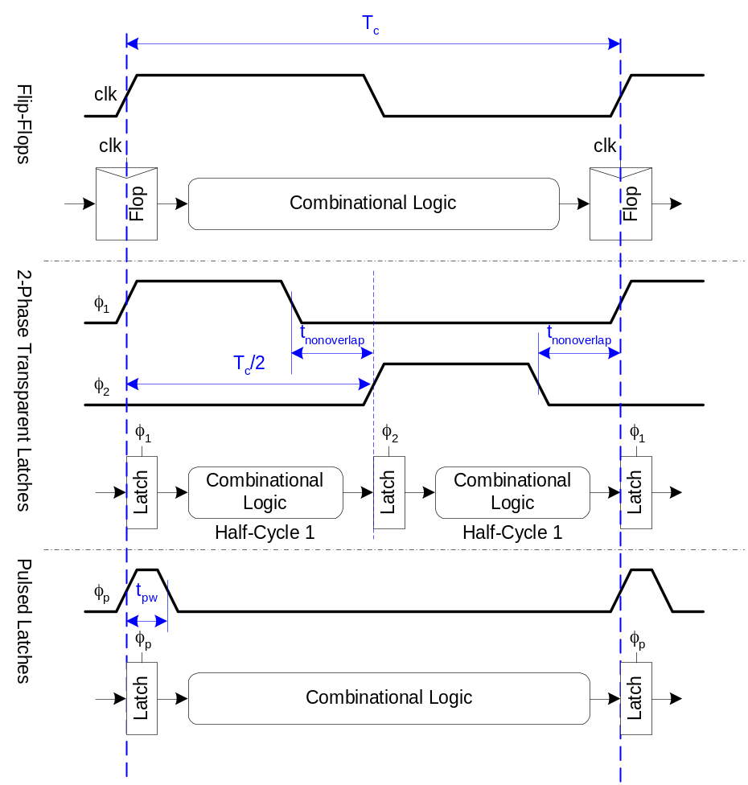
Sequencing Methods
Flip-flops
2-Phase Latches
Pulsed Latches

Slide 11
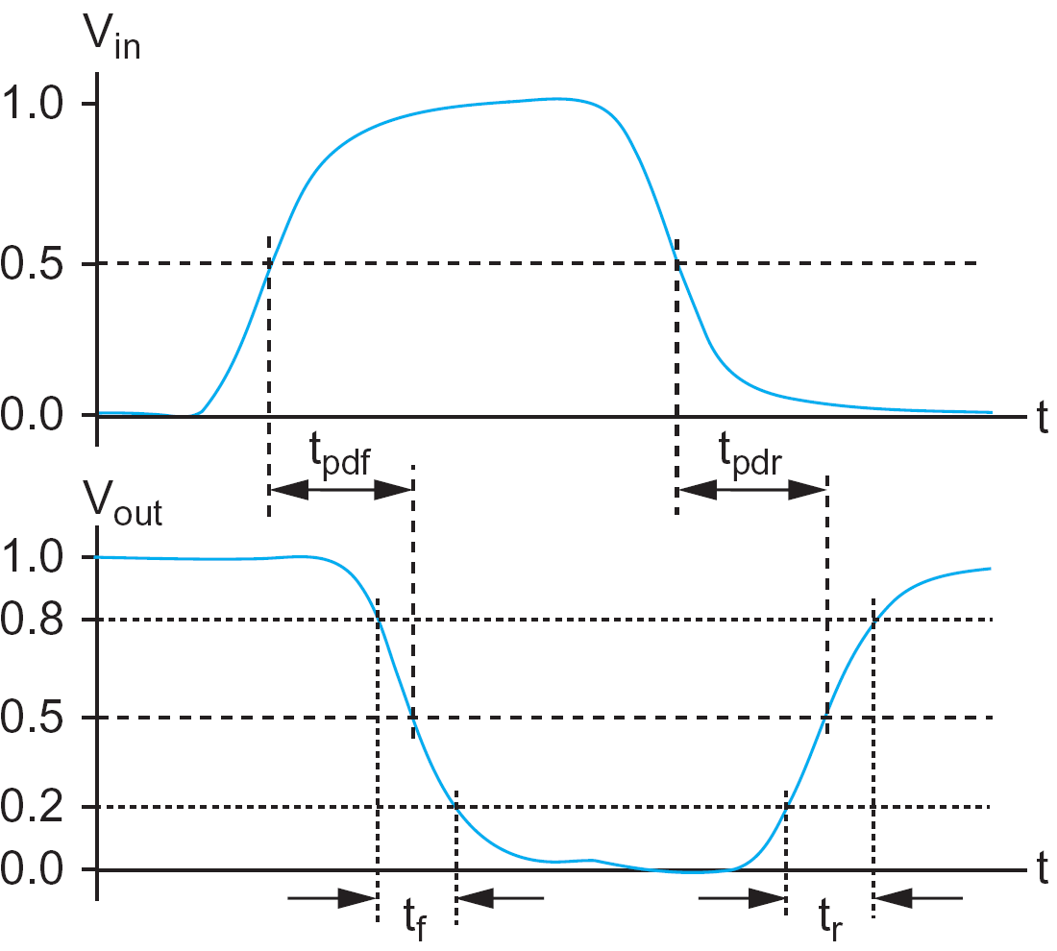
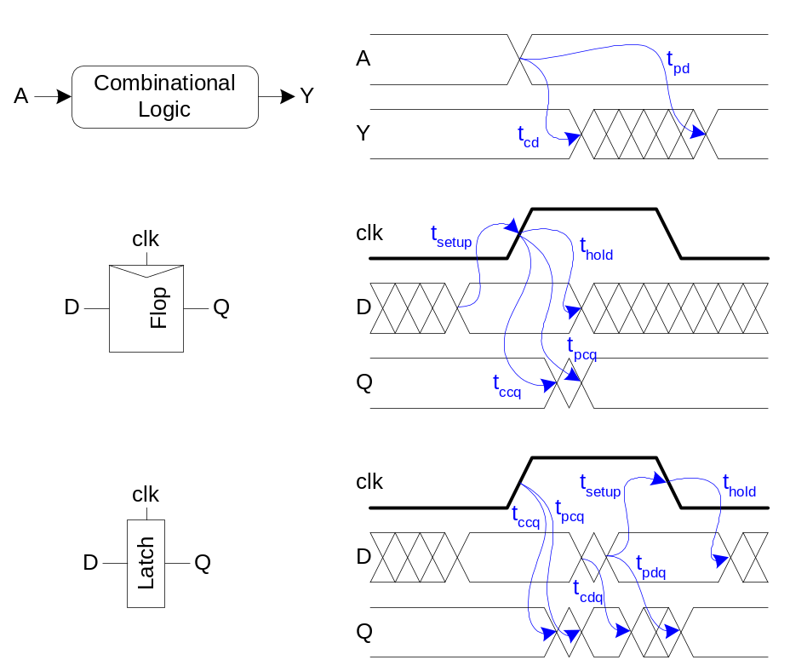
Timing Diagrams
Contamination and Propagation Delays
t_{pd} | Logic Prop. Delay
t_{cd} | Logic Cont. Delay
t_{pcq} | Latch/Flop Clk->Q Prop. Delay
t_{ccq} | Latch/Flop Clk->Q Cont. Delay
t_{pdq} | Latch D->Q Prop. Delay
t_{cdq} | Latch D->Q Cont. Delay
t_{setup} | Latch/Flop Setup Time
t_{hold} | Latch/Flop Hold Time

Slide 12
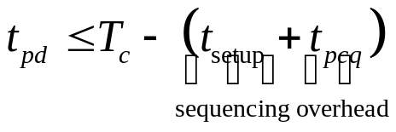
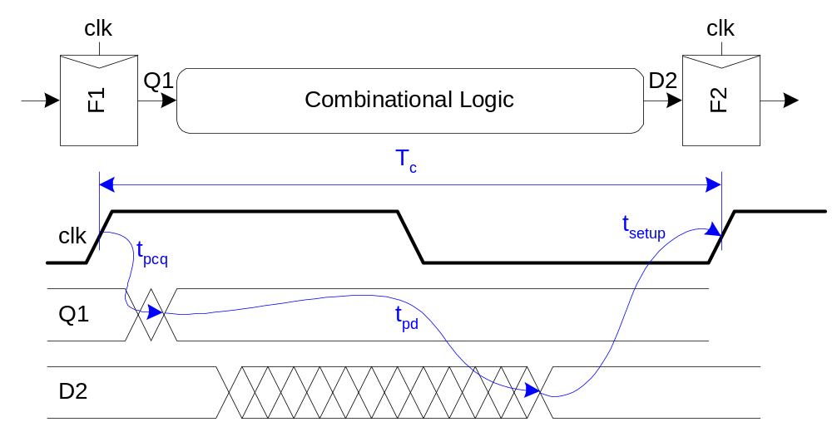
Max-Delay: Flip-Flops

Slide 13
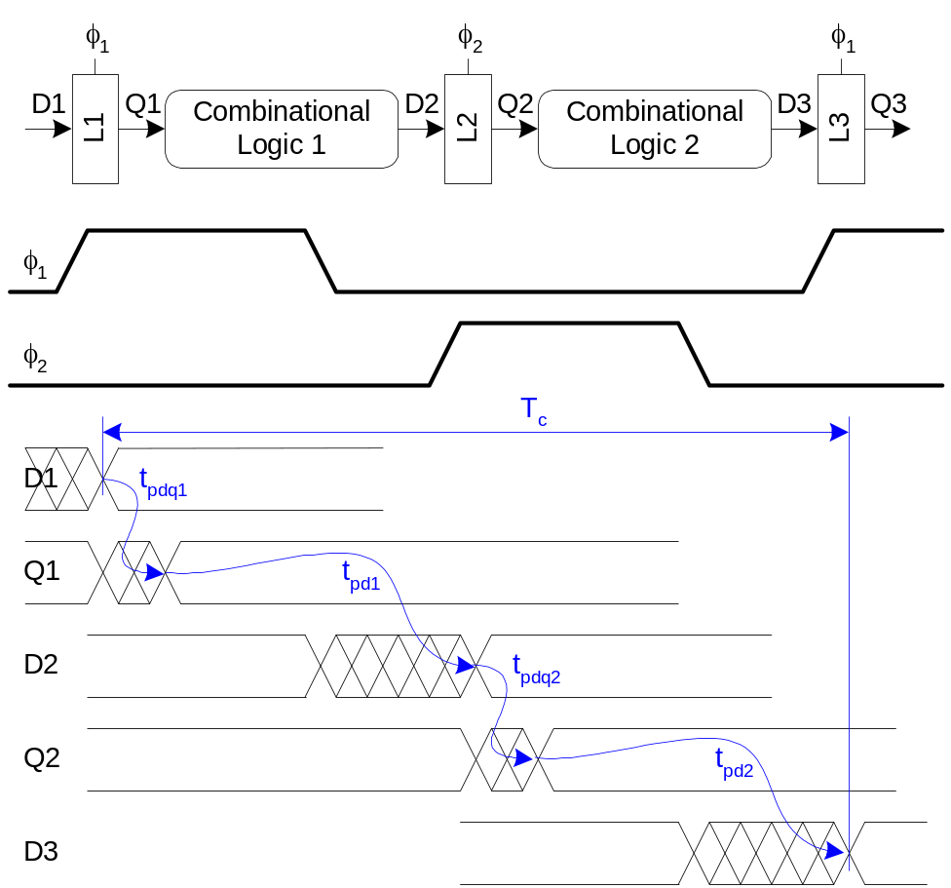
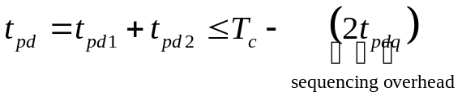
Max Delay: 2-Phase Latches

Slide 14
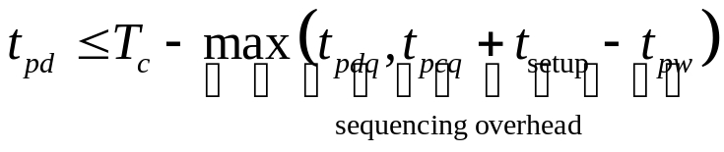
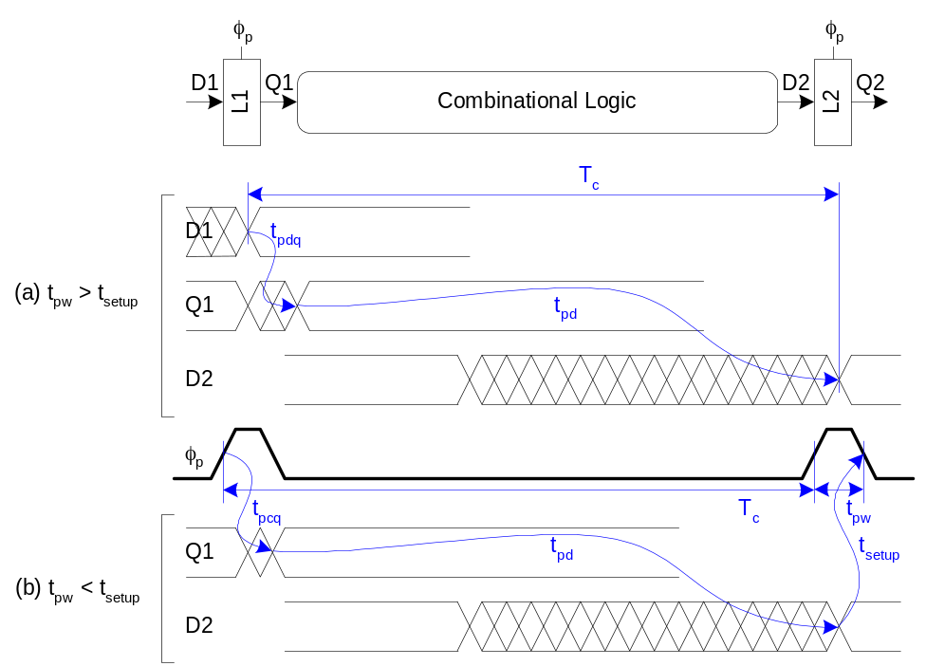
Max Delay: Pulsed Latches

Slide 15
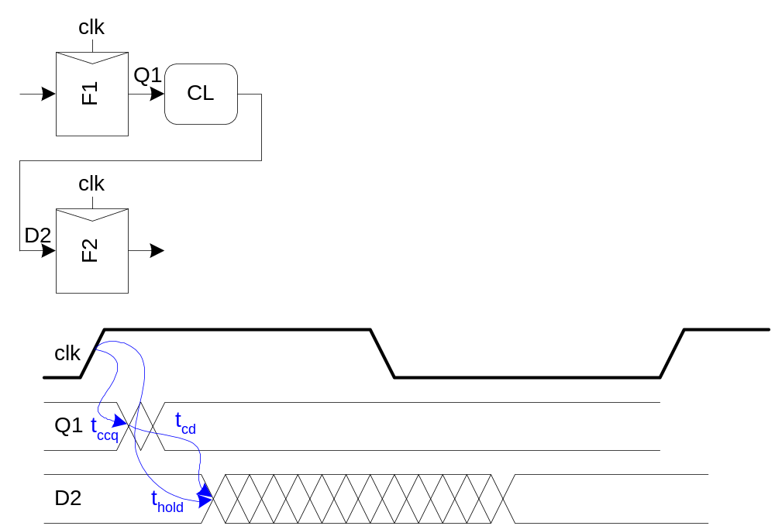

Min-Delay: Flip-Flops

Slide 16
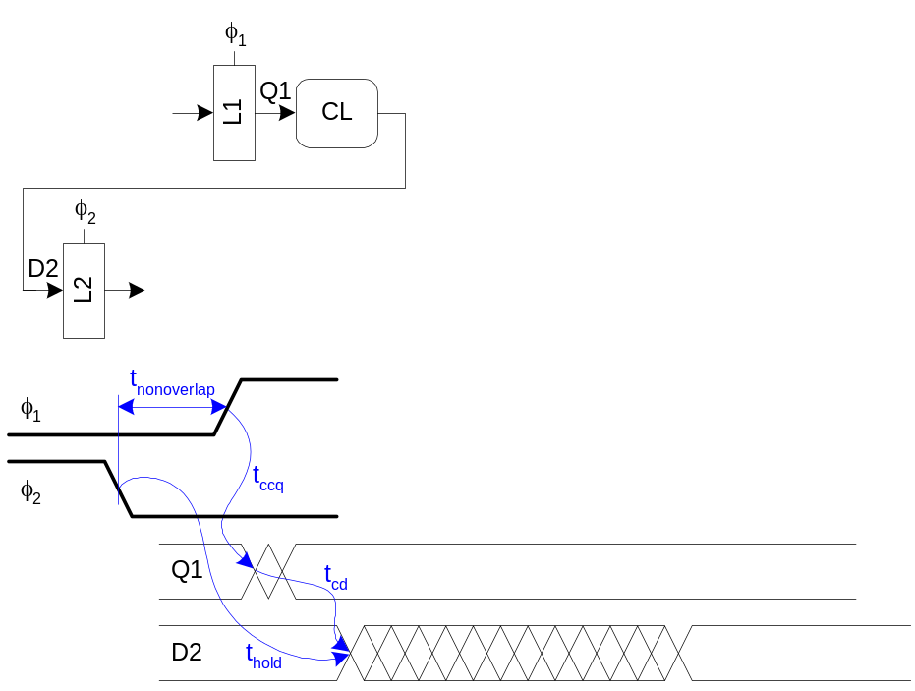

Min-Delay: 2-Phase Latches
Hold time reduced by nonoverlap
Paradox: hold applies twice each cycle, vs. only once for flops.
But a flop is made of two latches!

Slide 17
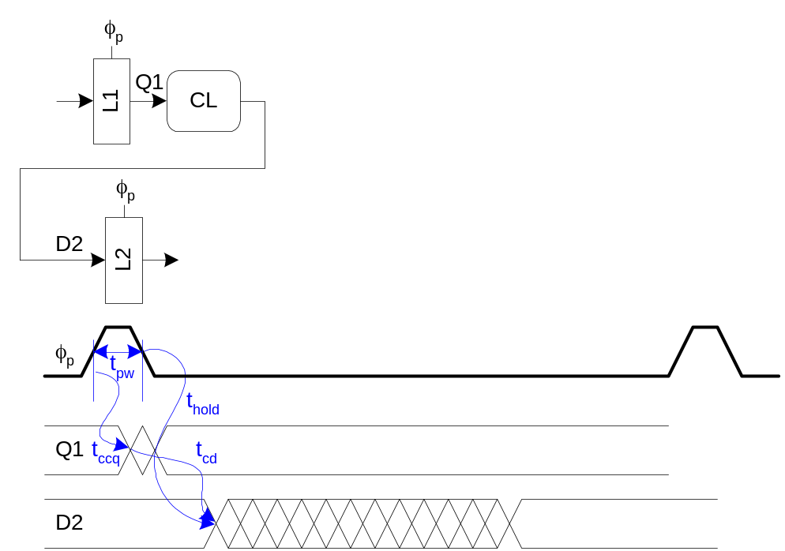

Min-Delay: Pulsed Latches
Hold time increased by pulse width

Slide 18
Time Borrowing
In a flop-based system:
  Data launches on one rising edge
  Must setup before next rising edge
  If it arrives late, system fails
  If it arrives early, time is wasted
  Flops have hard edges
In a latch-based system
  Data can pass through latch while transparent
  Long cycle of logic can borrow time into next
  As long as each loop completes in one cycle

Slide 19
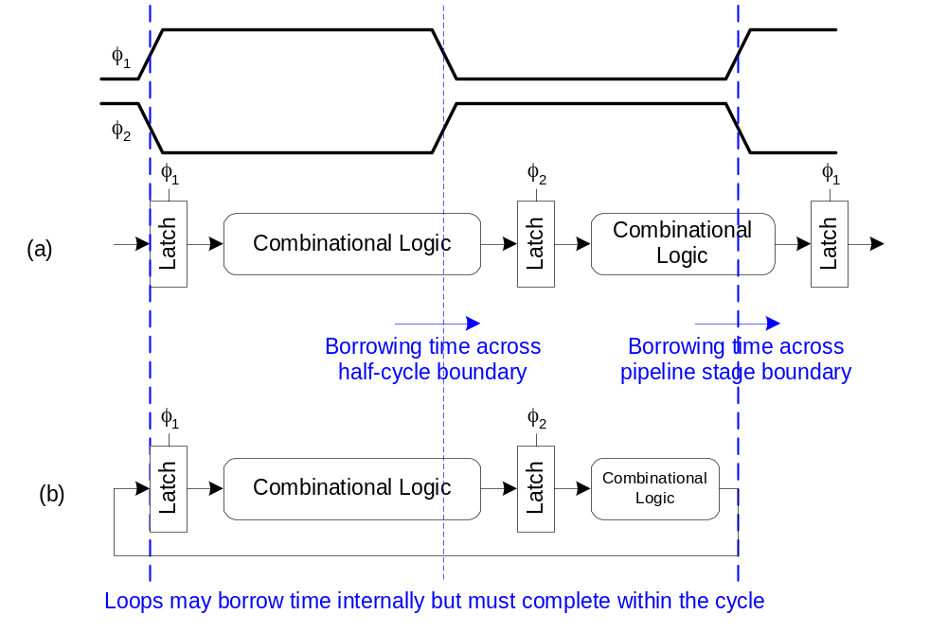
Time Borrowing Example

Slide 20
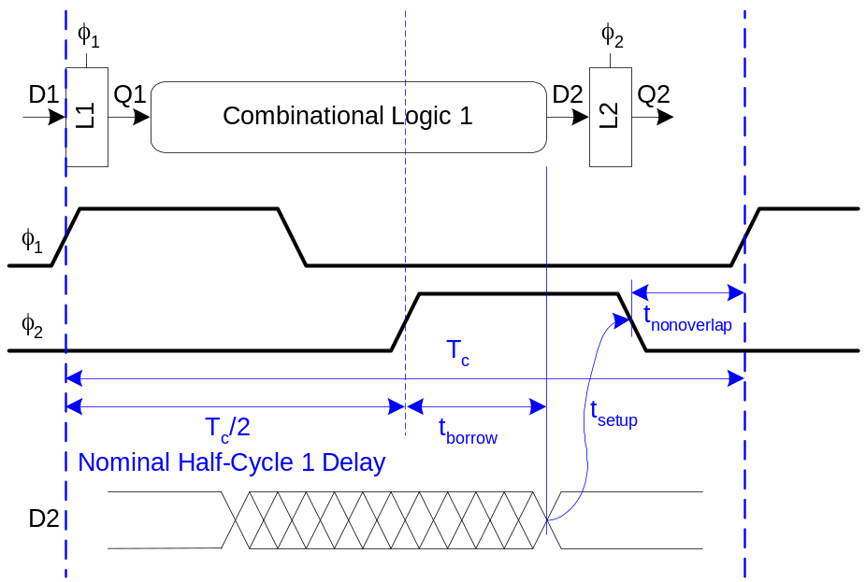
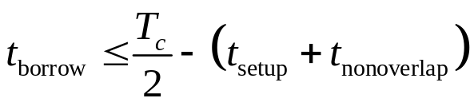

How Much Borrowing?
2-Phase Latches
Pulsed Latches

Slide 21
Clock Skew
We have assumed zero clock skew
Clocks really have uncertainty in arrival time
  Decreases maximum propagation delay
  Increases minimum contamination delay
  Decreases time borrowing

Slide 22
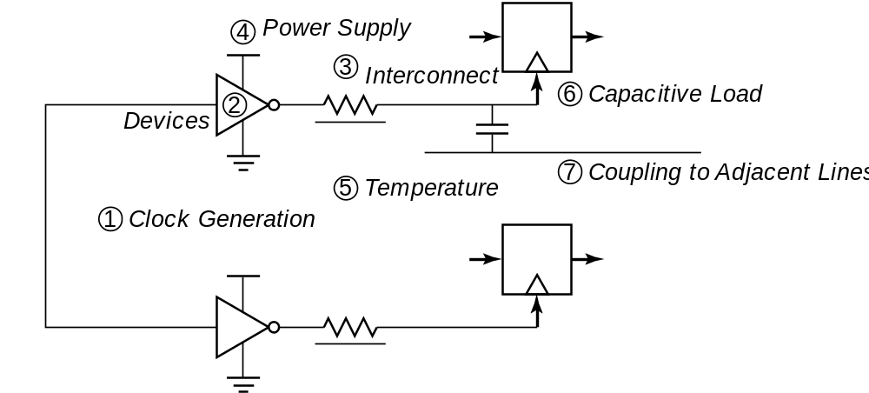
Clock Uncertainties
R₁
R₂
Sources of clock uncertainty

Slide 23
Clock Nonidealities
Clock skew
  Spatial variation in temporally equivalent clock edges; deterministic + random, t_{SK}
Clock jitter
  Temporal variations in consecutive edges of the clock signal; modulation + random noise
  Cycle-to-cycle (short-term) t_{JS}
  Long term t_{JL}
Variation of the pulse width
  Important for level sensitive clocking [latches]

Slide 24
Clock Skew and Jitter
Clk1
t_{SK}
Clk2
t_{JS}
Combinational Logic
R₁
R₂
Clk1
CLK
Clk2
Both skew and jitter affect the effective cycle time
Only skew affects the race margin

Slide 25
Clock Skew
# of registers
Earliest occurrence
of Clk edge
Nominal – δ/2
Latest occurrence
of Clk edge
Nominal + δ /2
Insertion delay
Clk delay
Max Clk skew
δ

Slide 26
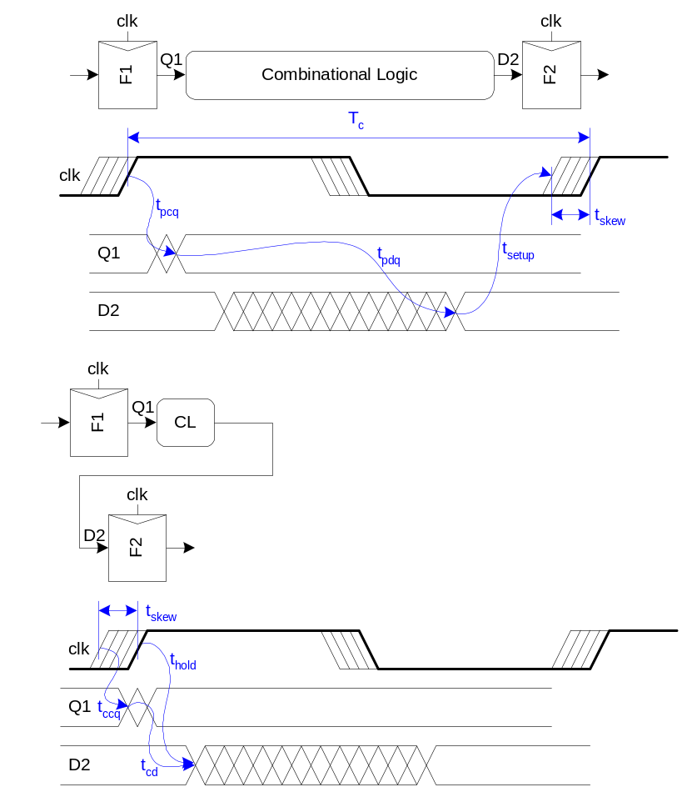
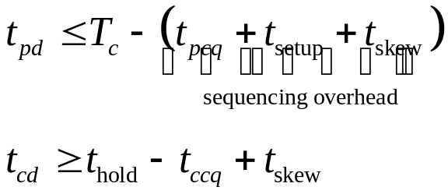
Skew: Flip-Flops

Slide 27
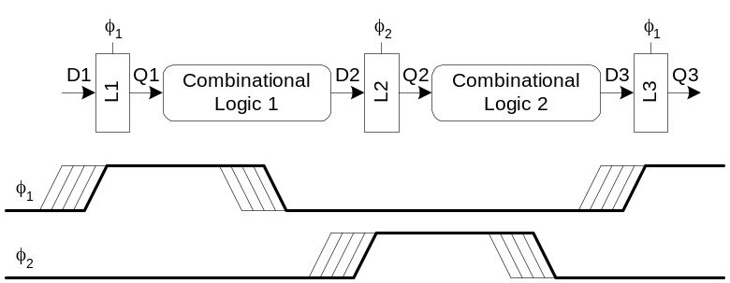
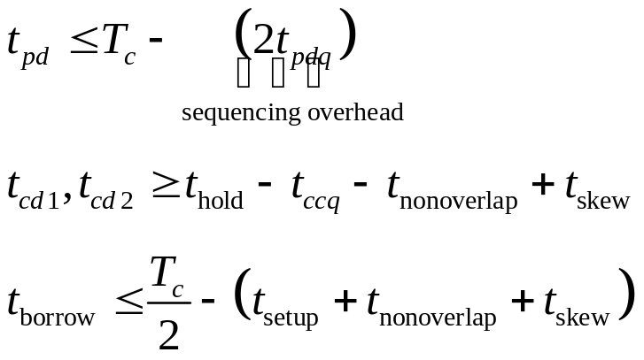
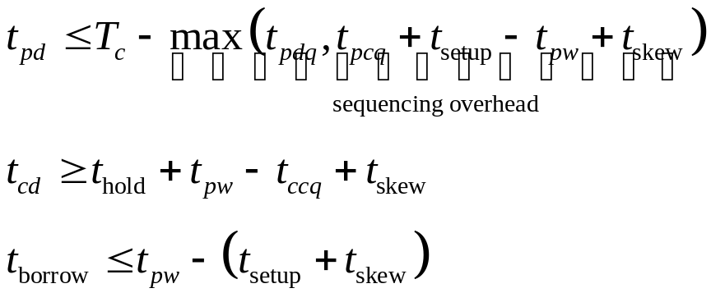
Skew: Latches
2-Phase Latches
Pulsed Latches

Slide 28
Two-Phase Clocking
If setup times are violated, reduce clock speed
If hold times are violated, chip fails at any speed
No tools to analyze clock skew
  An easy way to guarantee hold times is to use 2-phase latches with big nonoverlap times
Call these clocks φ₁, φ₂ (ph1, ph2)

Slide 29
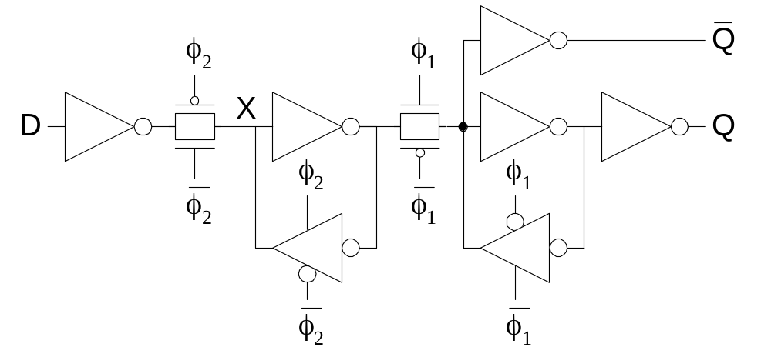
Safe Flip-Flop
Past years used flip-flop with nonoverlapping clocks
  Slow – nonoverlap adds to setup time
  But no hold times
In industry, use a better timing analyzer
  Add buffers to slow signals if hold time is at risk

Slide 30
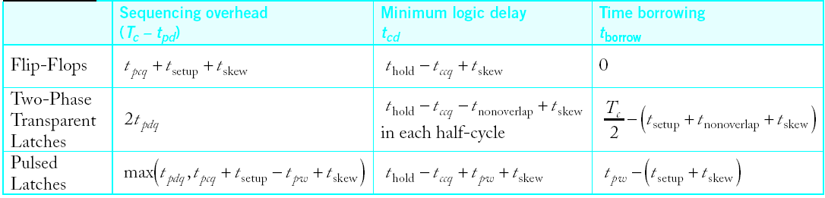
Sequencing Summary
Flip-Flops:
  Very easy to use, supported by all tools
2-Phase Transparent Latches:
  Lots of skew tolerance and time borrowing
Pulsed Latches:
  Fast, some skew tol & borrow, hold time risk

Slide 31
Reference
Reference [1]. Chapter 10.1-10.3

Slide 32
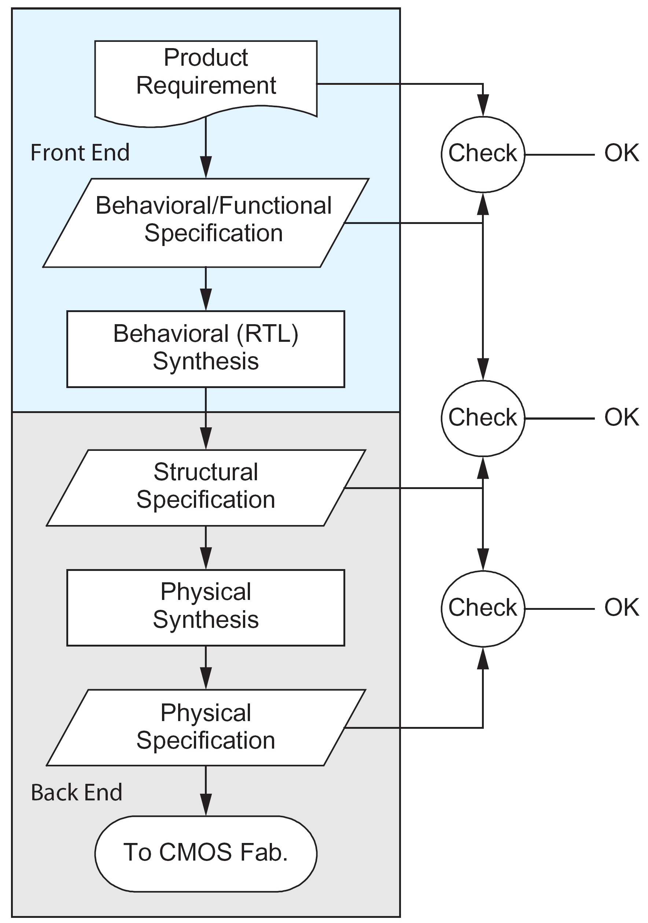
STA in ASIC Design Flow
Static Timing Analysis

